Slide 1
Finite State Machine (FSM)
FSM:
  Generalized models of a sequential circuit
  How the elements can be connected
    Next state combinational logic
    Memory (F/F, Registers)
    Output combinational logic
Two Common Types FSM
  Mealy Machine: O/P is function of present state and input.
  Moore Machine: O/P is function of only present state.
Examples (already seen)

Slide 2
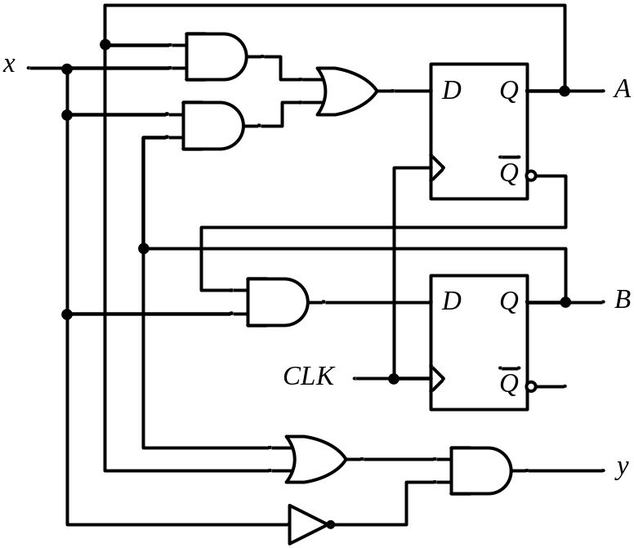
State Table (Previous Lec)
Example
Present State |  | Input | Next State |  | Output
A | B | x | A | B | y
0 | 0 | 0
0 | 0 | 1
0 | 1 | 0
0 | 1 | 1
1 | 0 | 0
1 | 0 | 1
1 | 1 | 0
1 | 1 | 1
0 0 0
0 1 0
0 0 1
1 1 0
0 0 1
1 0 0
0 0 1
1 0 0
A(t+1) = A x + B x
B(t+1) = A’ x
y(t) = (A + B) x’
For the same state,
the output changes with the input
O/p depends on: both the present states and the I/p

Slide 3
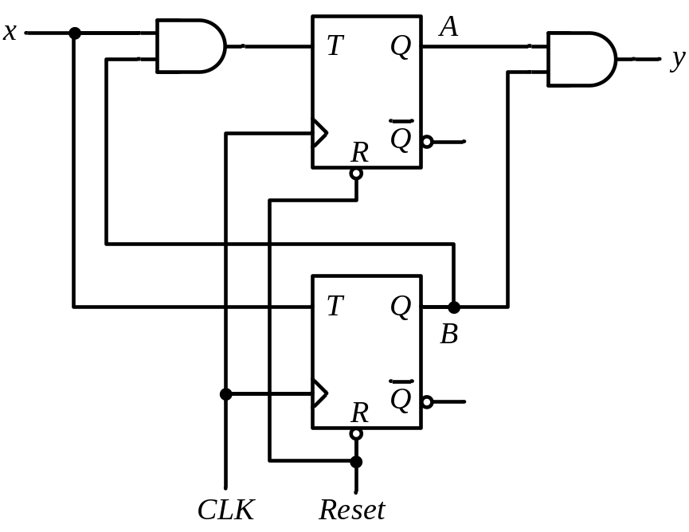
Analysis of CLK Seq. Ccts (T-F/F)
Present State |  | I/P | Next State |  | F.F Inputs |  | O/P
A | B | x | A | B | T_{A} | T_{B} | y
0 | 0 | 0
0 | 0 | 1
0 | 1 | 0
0 | 1 | 1
1 | 0 | 0
1 | 0 | 1
1 | 1 | 0
1 | 1 | 1
0 0
0 1
0 1
1 0
1 0
1 1
1 1
0 0
0 0
0 1
0 0
1 1
0 0
0 1
0 0
1 1
0
0
0
0
0
0
1
1
T_{A} = B x T_{B} = x
y = A B
A(t+1) = T_{A} Q’_{A} + T’_{A} Q_{A}
= AB’ + Ax’ + A’Bx
B(t+1) = T_{B} Q’_{B} + T’_{B} Q_{B}
= x ⊕ B
For the same state,
the output does not change with the input
O/p depends only on the present states

Slide 4
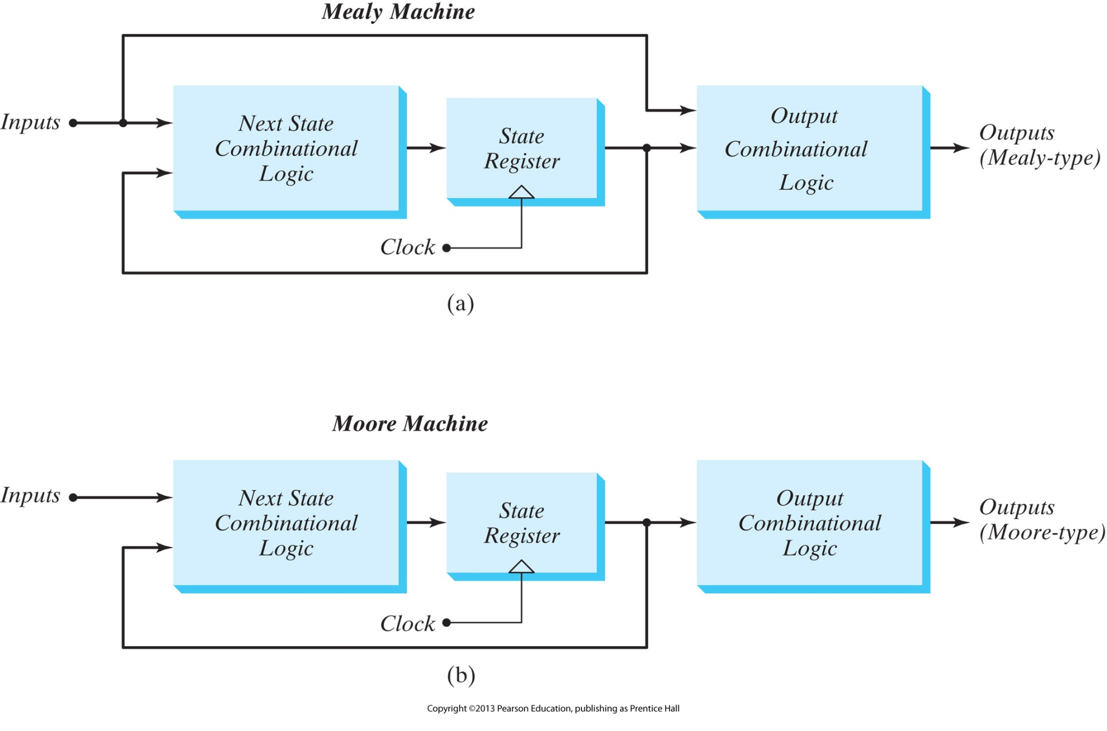
FSM Model for Mealy Machine
The output is a function of both the present state and the input
The output changes asynchronous to the clock.
Difficult to do timing analysis.

Slide 5
FSM Model for Moore Machine
The output is a function of only the present state
The output changes synchronous to the clock
Easier Timing Analysis

Slide 6
Moore State Diagram
(Another Representation)
State / Output
0
0
1
0 0 / 0
0 1 / 0
1
1
1 1 / 1
1 0 / 0
0/0
1
0/0
0
0
0 0
1/0
0 1
O/p is not depending on I/p.
It is only dependent upon present states
1/1
1/0
1 1
1 0
0/0
0/1
1/0

Slide 7
State Reduction:
Analysis:
  Circuit diagram → State Table / State Diagram
Design (Synthesis):
  State Table / State Diagram → Circuit diagram
Redundant/ equivalent State:
  Redundant state may exist in state table or diagram.
  By eliminating the redundant state, we can reduce number of logic gates and flip flops.
Suppose:
  I/O sequences are important
  The internal states are used merely to provide the required sequences
Algorithm:

Slide 8
State Reduction - Algorithm
When two states are equivalent, one of them can
be removed without altering the input–output relationships
Two states are said to be equivalent if, for each member of the set of inputs, they give exactly the same output and send the circuit either to the
same state or to an equivalent state

Slide 9
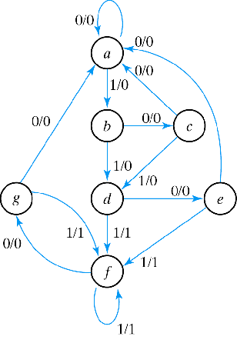
Example-1(Row Matcing)
State Transition Table
NS output
PS x=0 x=1 x=0 x=1
a a b 0 0
b c d 0 0
c a d 0 0
d e f 0 1
e a f 0 1
f g f 0 1
g a f 0 1

Slide 10
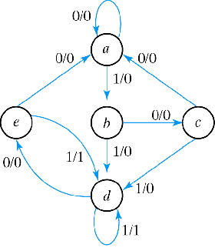
Example-1
NS output
PS x=0 x=1 x=0 x=1
a a b 0 0
b c d 0 0
c a d 0 0
d e f 0 1
e a f 0 1
f e f 0 1
Reduced State Transition Diagram
NS output
PS x=0 x=1 x=0 x=1
a a b 0 0
b c d 0 0
c a d 0 0
d e d 0 1
e a d 0 1

Slide 11
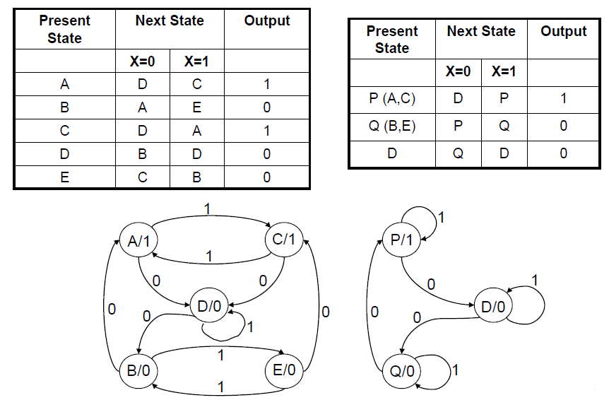
Example-2(Implication Method)

Slide 12
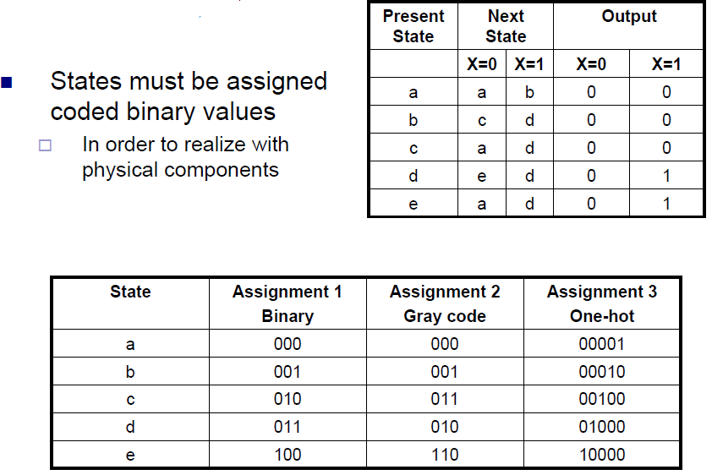
State Assignment:

Slide 13
Sequential Circuits– Design Procedure
Procedure
Draw state transition diagram
Make state table
Reduced state table (if possible)
Choose flip-flop type
Derive simplified flip-flop input equations and output equations
Draw the logic diagram

Slide 14
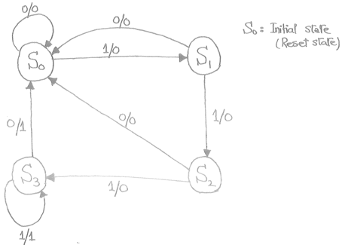
Synthesis using D flip flop:
Example: Detect 3 or more consecutive 1’s
State | A B
S₀ | 0 0
S₁ | 0 1
S₂ | 1 0
S₃ | 1 1

Slide 15
Example: Detect 3 or more consecutive 1’s
0
1
S₀ / 0
S₁ / 0
0
State | A B
S₀ | 0 0
S₁ | 0 1
S₂ | 1 0
S₃ | 1 1
0
1
0
S₃ / 1
S₂ / 0
1
1

Slide 16
Example: Detect 3 or more consecutive 1’s
Present State |  | Input | Next State |  | Output
A | B | x | A | B | y
0 | 0 | 0
0 | 0 | 1
0 | 1 | 0
0 | 1 | 1
1 | 0 | 0
1 | 0 | 1
1 | 1 | 0
1 | 1 | 1
0
1
0 0 0
0 1 0
0 0 0
1 0 0
0 0 0
1 1 0
0 0 1
1 1 1
S₀ / 0
S₁ / 0
0
0
1
0
S₃ / 1
S₂ / 0
1
1

Slide 17
Example: Detect 3 or more consecutive 1’s
Present State |  | Input | Next State |  | Output
A | B | x | A | B | y
0 | 0 | 0
0 | 0 | 1
0 | 1 | 0
0 | 1 | 1
1 | 0 | 0
1 | 0 | 1
1 | 1 | 0
1 | 1 | 1
Synthesis using D Flip-Flops
0 0 0
0 1 0
0 0 0
1 0 0
0 0 0
1 1 0
0 0 1
1 1 1
A(t+1) = D_{A} (A, B, x)
= ∑ (3, 5, 7)
B(t+1) = D_{B} (A, B, x)
= ∑ (1, 5, 7)
y (A, B, x) = ∑ (6, 7)

Slide 18
Example: Detect 3 or more consecutive 1’s
Synthesis using D Flip-Flops
 |  |  |  | B
 |  | 0 | 0 | 1 | 0
A |  | 0 | 1 | 1 | 0
 |  |  | x
D_{A} (A, B, x) = ∑ (3, 5, 7)
= A x + B x
D_{B} (A, B, x) = ∑ (1, 5, 7)
= A x + B’ x
y (A, B, x) = ∑ (6, 7)
= A B
 |  |  |  | B
 |  | 0 | 1 | 0 | 0
A |  | 0 | 1 | 1 | 0
 |  |  | x
 |  |  |  | B
 |  | 0 | 0 | 0 | 0
A |  | 0 | 0 | 1 | 1
 |  |  | x

Slide 19
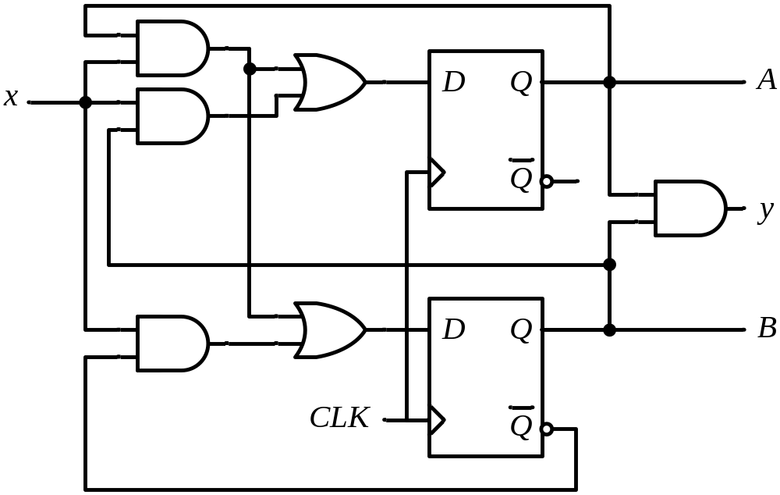
Example: Detect 3 or more consecutive 1’s
Synthesis using D Flip-Flops
D_{A} = A x + B x
D_{B} = A x + B’ x
y = A B

Slide 20
F/F Excitation Table (JK)
Characteristic Table
Excitation Table
Present State | Next State | F.F. Input
Q(t) | Q(t+1) | J | K
0 | 0
0 | 1
1 | 0
1 | 1
J | K | Q(t+1)
0 | 0 | Q(t)
0 | 1 | 0
1 | 0 | 1
1 | 1 | Q’(t)
No change
Reset
Set
Toggle
0 0 (No change)
0 1 (Reset)
0 x
1 x
x 1
x 0
1 0 (Set)
1 1 (Toggle)
0 1 (Reset)
1 1 (Toggle)
0 0 (No change)
1 0 (Set)
Q(t+1) = 0 Kab kab?
J =0, K = 1
J =0, K = 0 (because Q(t+1) = Q(t) = 0)

Slide 21
3 (or more) Consecutive 1’s Detector ̶ Using JK
Present State |  | Input | Next State |  | Flip-Flop Inputs
A | B | x | A | B | J_{A} | K_{A} | J_{B} | K_{B}
0 | 0 | 0 | 0 | 0
0 | 0 | 1 | 0 | 1
0 | 1 | 0 | 0 | 0
0 | 1 | 1 | 1 | 0
1 | 0 | 0 | 0 | 0
1 | 0 | 1 | 1 | 1
1 | 1 | 0 | 0 | 0
1 | 1 | 1 | 1 | 1
Synthesis using JK F.F.
0 x
0 x
0 x
1 x
x 1
x 0
x 1
x 0
0 x
1 x
x 1
x 1
0 x
1 x
x 1
x 0
J_{A} (A, B, x) = ∑ (3)
d_{JA} (A, B, x) = ∑ (4,5,6,7)
K_{A} (A, B, x) = ∑ (4, 6)
d_{KA} (A, B, x) = ∑ (0,1,2,3)
J_{B} (A, B, x) = ∑ (1, 5)
d_{JB} (A, B, x) = ∑ (2,3,6,7)
K_{B} (A, B, x) = ∑ (2, 3, 6)
d_{KB} (A, B, x) = ∑ (0,1,4,5)

Slide 22
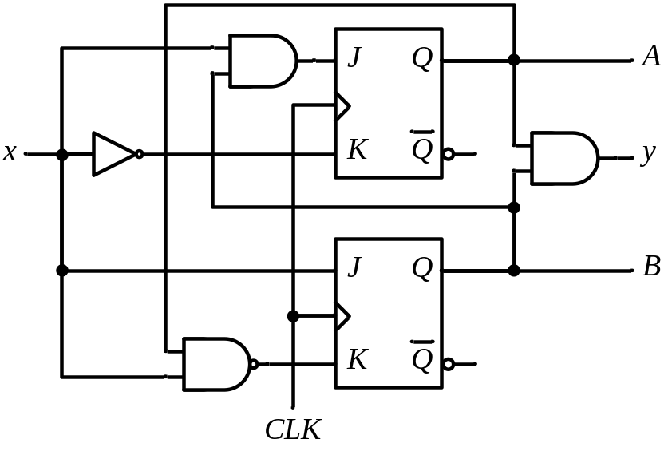
3 (or more) Consecutive 1’s Detector ̶ Using JK
Synthesis using JK Flip-Flops
J_{A} = B x K_{A} = x’
J_{B} = x K_{B} = A’ + x’
 |  |  |  | B
 |  | 0 | 0 | 1 | 0
A |  | x | x | x | x
 |  |  | x
 |  |  |  | B
 |  | x | x | x | x
A |  | 1 | 0 | 0 | 1
 |  |  | x
 |  |  |  | B
 |  | 0 | 1 | x | x
A |  | 0 | 1 | x | x
 |  |  | x
 |  |  |  | B
 |  | x | x | 1 | 1
A |  | x | x | 0 | 1
 |  |  | x

Slide 23
F/F Excitation Table (T)
Characteristic Table
Excitation Table
Q(t) | Q(t+1) | T
0 | 0
0 | 1
1 | 0
1 | 1
T | Q(t+1)
0 | Q(t)
1 | Q’(t)
0
1
1
0
No change
Toggle

Slide 24
3 (or more) Consecutive 1’s Detector ̶ Using T
Present State |  | Input | Next State |  | F.F. Input
A | B | x | A | B | T_{A} T_{B}
0 | 0 | 0 | 0 | 0
0 | 0 | 1 | 0 | 1
0 | 1 | 0 | 0 | 0
0 | 1 | 1 | 1 | 0
1 | 0 | 0 | 0 | 0
1 | 0 | 1 | 1 | 1
1 | 1 | 0 | 0 | 0
1 | 1 | 1 | 1 | 1
Synthesis using T Flip-Flops
0
0
0
1
1
0
1
0
0
1
1
1
0
1
1
0
T_{A} (A, B, x) = ∑ (3, 4, 6)
T_{B} (A, B, x) = ∑ (1, 2, 3, 5, 6)

Slide 25
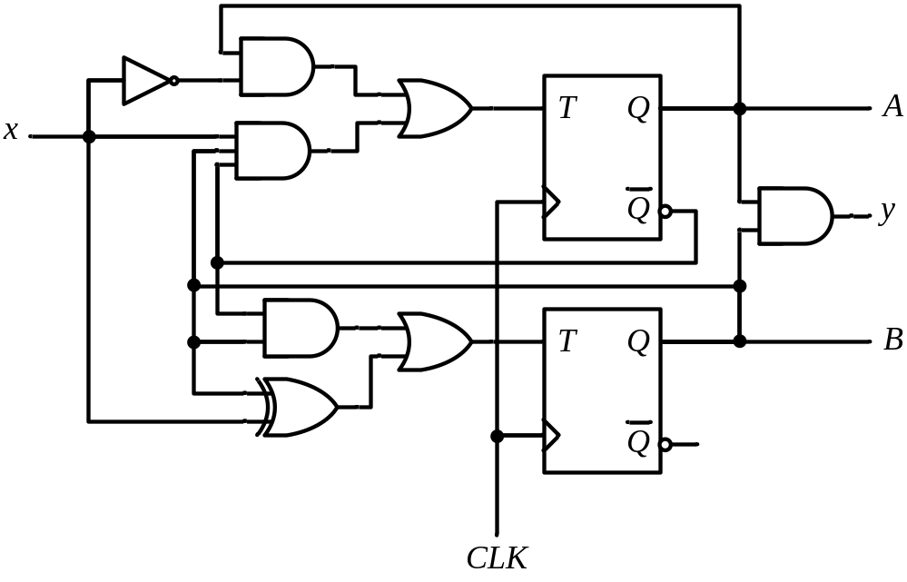
3 (or more) Consecutive 1’s Detector ̶ Using T
Synthesis using T Flip-Flops
T_{A} = A x’ + A’ B x
T_{B} = A’ B + B ⊕ x
 |  |  |  | B
 |  | 0 | 0 | 1 | 0
A |  | 1 | 0 | 0 | 1
 |  |  | x
 |  |  |  | B
 |  | 0 | 1 | 1 | 1
A |  | 0 | 1 | 0 | 1
 |  |  | x

Slide 26
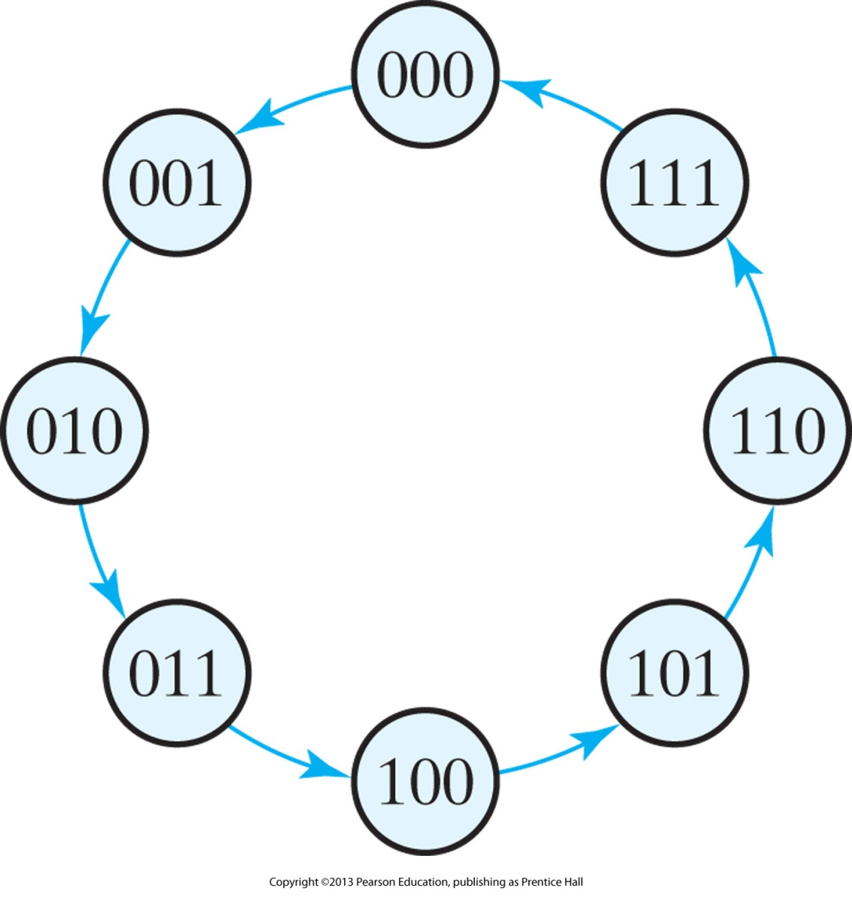
Example 2: 3 Bit Binary Counter Using T F/F

Slide 27
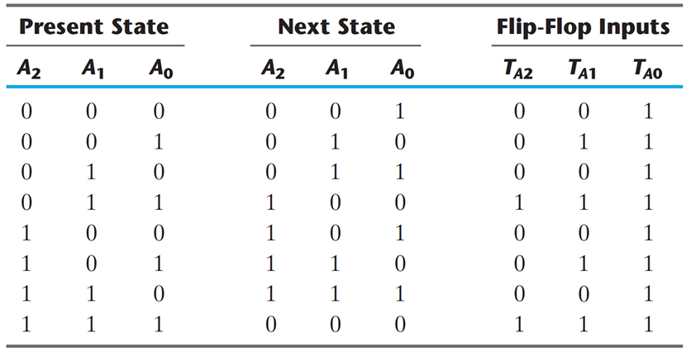
Example 2: 3 Bit Binary Counter Using T F/F

Slide 28
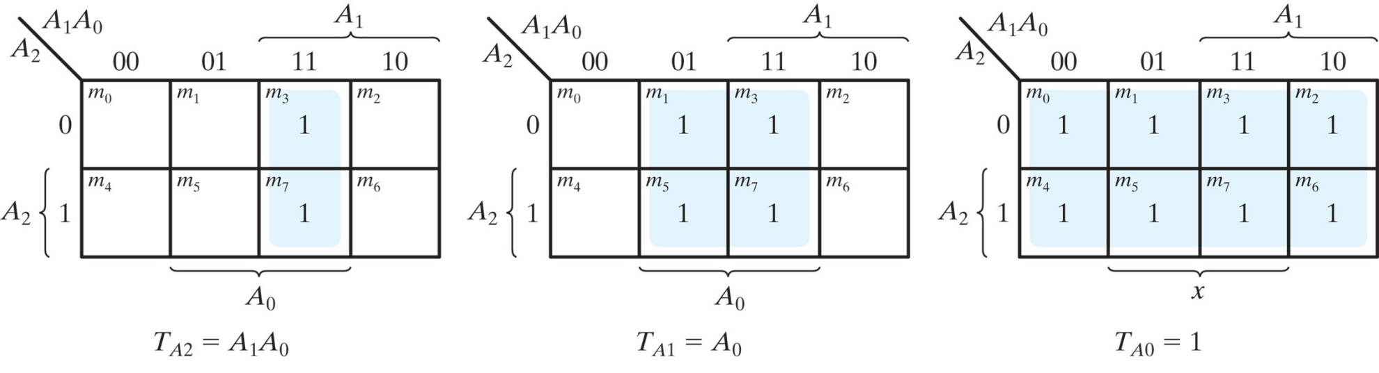
Example 2: 3 Bit Binary Counter Using T F/F

Slide 29
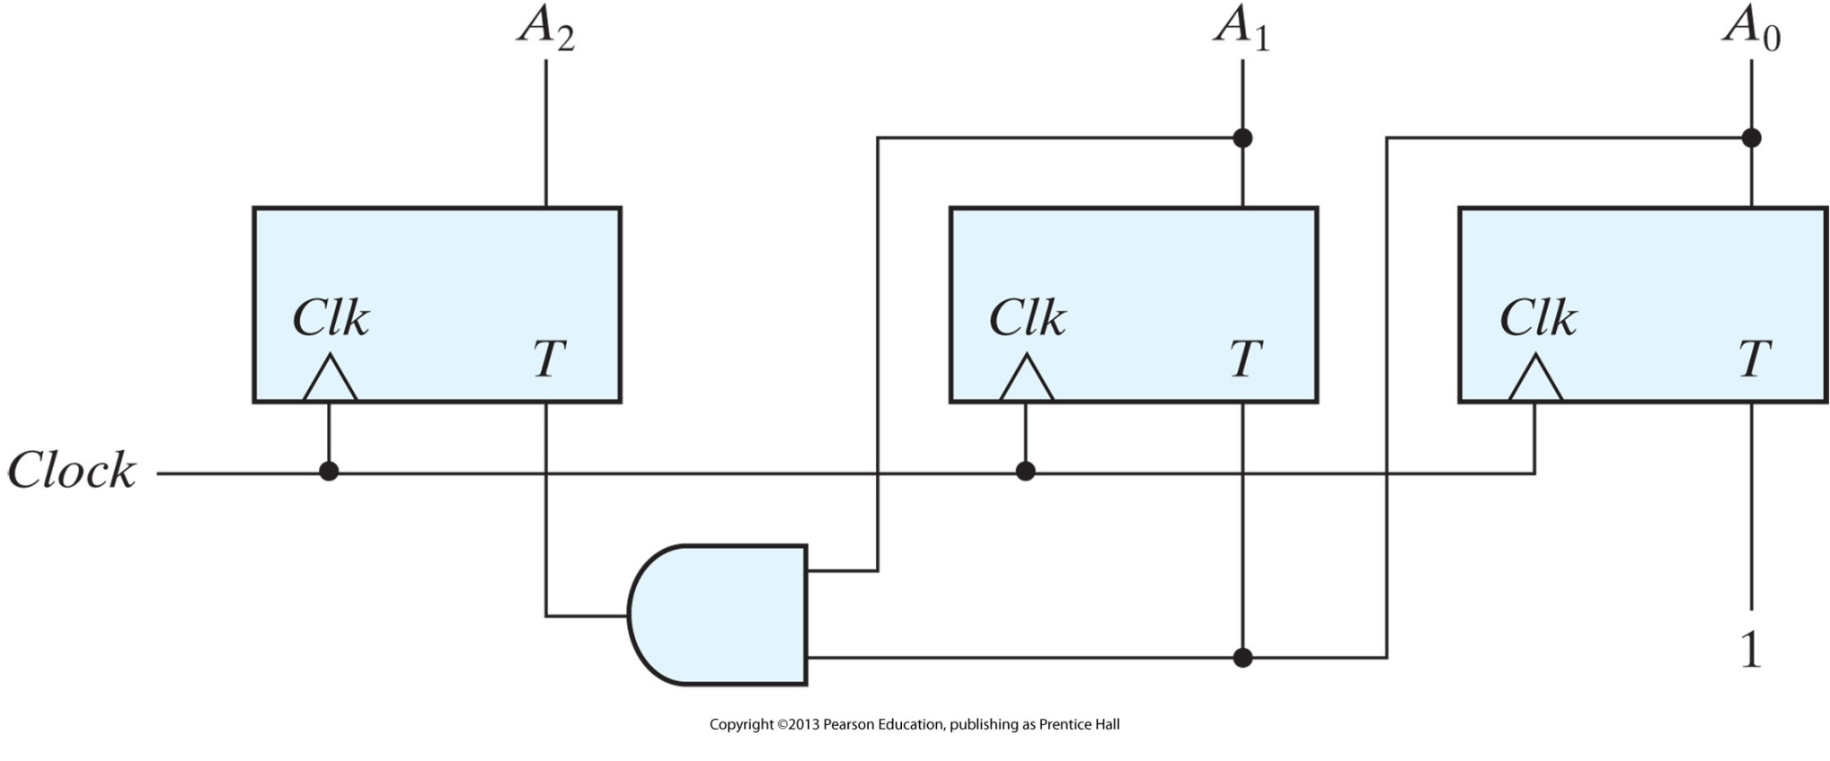
Example 2: 3 Bit Binary Counter Using T F/F

